Slide 1
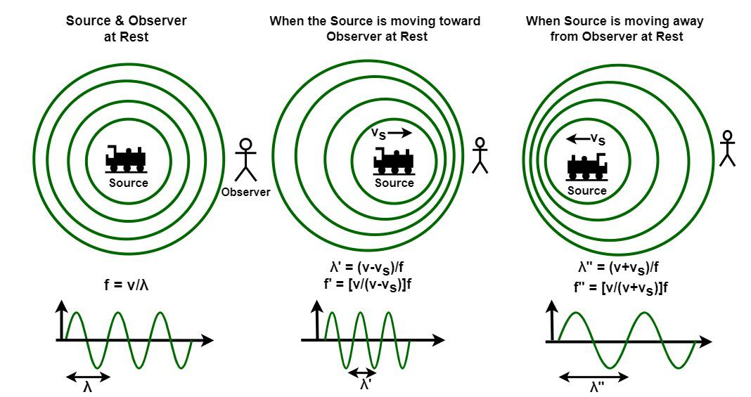
INTRODUCTION
Doppler’s Effect is a physical phenomenon that describes the change in the frequency of sound heard by an observer when either the source of the sound or the observer or both are in motion relative to each other. This effect was first explained by Christian Doppler in 1842.

Slide 2
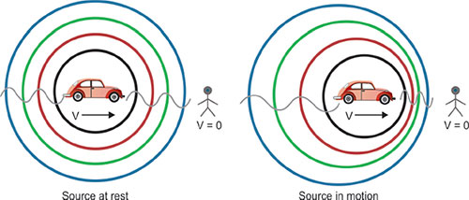
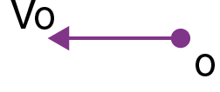
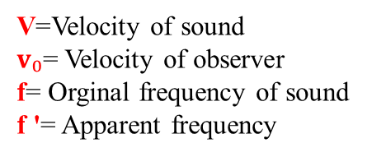

CASE I:
1. Observer moves towards stationary source.
Here, the observer is moving toward the source. The observer meets the sound waves faster than normal. This causes the observer to hear a higher frequency, even though the source frequency remains the same.
Apparent frequency heard by observer is,
f '=$\frac{v′}{\text{λ}}$……………(i)
Here, $v′$= $v+v₀$, so equation (i) can be written as,
f$′$=$\frac{v+v₀ }{\text{λ}}$
f '=$( \frac{v+v₀}{\text{v}})$f [ ⸪ v= $\text{λ}$f ]
V=Velocity of sound
$v₀$= Velocity of observer
f= Orginal frequency of sound
f '= Apparent frequency

Slide 3
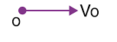
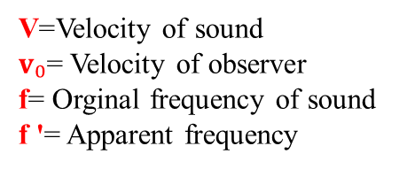

CASE II:
1. Observer moves away from stationary source.
Here, the source is stationary, and the observer is moving away from the source.
Since the observer is moving away, they meet the sound waves less frequently than normal.
This causes the apparent frequency to decrease, even though the source frequency remains the same.
Apparent frequency heard by observer is,
f '=$\frac{v′}{\text{λ}}$……………(ii)
Here, $v′$= $v−v₀$, so equation (ii) can be written as,
f$′$=$\frac{v−v₀ }{\text{λ}}$
f '= $\left( \frac{v−v^{0}}{\text{v}}\right)$f [ ⸪ v= $\text{λ}$f ]
V=Velocity of sound
$v₀$= Velocity of observer
f= Orginal frequency of sound
f '= Apparent frequency

Slide 4
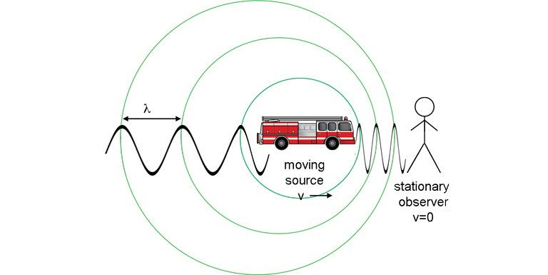
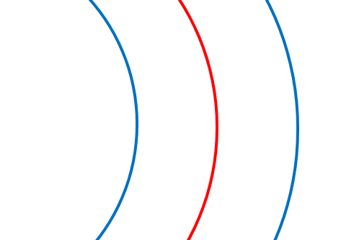

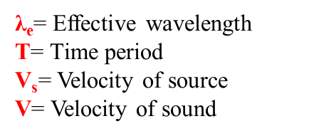
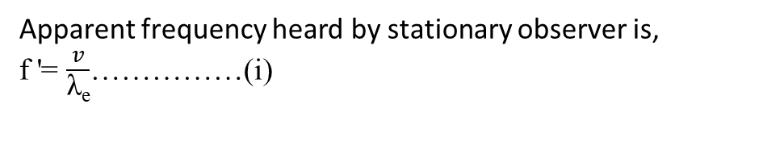


CASE III:
1. Source moves towards stationary observer.
When the sound source moves towards a stationary observer, it creates compressed sound waves in front of it. Because these waves are closer together, the observer hears a higher frequency than the actual frequency produced by the source.
$\text{λ}$= vT
Apparent frequency heard by stationary observer is,
f '= $\frac{v}{\text{λ}\text{e}}$……………(i)
λ_{e}= Effective wavelength
T= Time period
$\text{V}\text{s}$= Velocity of source
V= Velocity of sound
From fig:
λ_{e}= vT – v_{s}T
λ_{e}= $\frac{\text{v} \text{– }\text{v}\text{s} }{f}$
Then,
f ' = $\left( \frac{v}{\text{v}\text{−}\text{vs}}\right)$f
……………………………
……………………………
……………………………
VsT
λ_{e}

Slide 5
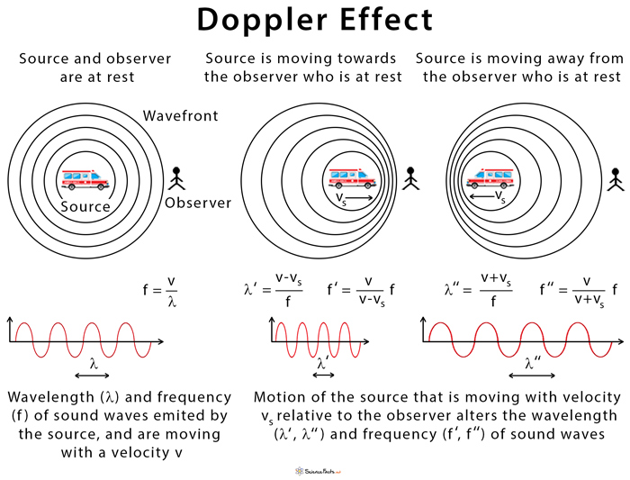
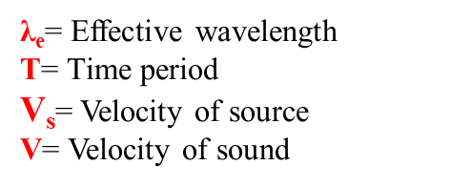

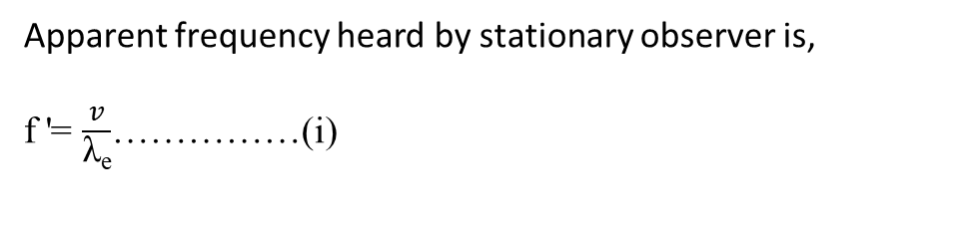
CASE IV:
1. Source moves away from stationary observer.
When the sound source moves away from a stationary observer, the sound waves spread out and the observer receives fewer waves per second. As a result, the observer hears a lower apparent frequency than the actual frequency.
Apparent frequency heard by stationary observer is,
f '= $\frac{v}{\text{λ}\text{e}}$……………(i)
λ_{e}= Effective wavelength
T= Time period
$\text{V}\text{s}$= Velocity of source
V= Velocity of sound
Similarly,
λ_{e}= $\frac{\text{v}\text{ + }\text{v}\text{s} }{f}$
Then,
f ' = $\left( \frac{v}{\text{v}\text{+}\text{vs}}\right)$f

Slide 6
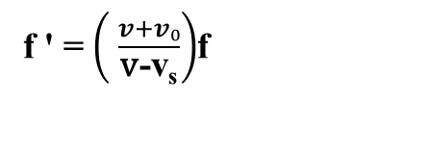


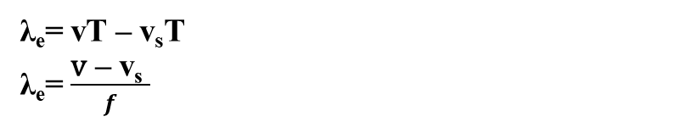
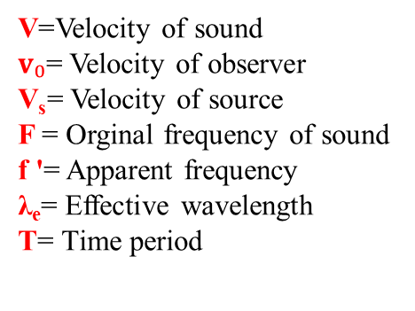
CASE V:
1.Both source and observer move towards each other.
When both the source and the observer move toward each other, the observer meets sound waves much faster than normal. The waves become more compressed, so the apparent frequency becomes much higher than the actual frequency.
When the source moves toward the observer it compresses the sound waves, reducing the wavelength,
λ_{e}= vT – v_{s}T
λ_{e}= $\frac{\text{v}\text{ – }\text{v}\text{s} }{f}$
The observer moves toward the incoming waves, so effective speed of waves relative to observer,
$v′$= $v+v₀$
V=Velocity of sound
$v₀$= Velocity of observer
$\text{V}\text{s}$= Velocity of source
F = Orginal frequency of sound
f '= Apparent frequency
λ_{e}= Effective wavelength
T= Time period
Apparent frequency heard,
f '= $\frac{v′}{\text{λ}\text{e}}$
Substituting values,
f ' = $\left( \frac{v+v₀}{\text{v}\text{−}\text{vs}}\right)$f

Slide 7

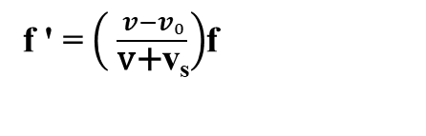

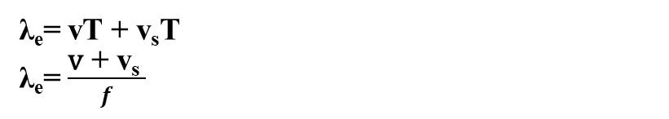
CASE VI:
1.Both source and observer move away from each other.
When both the source and the observer move away from each other, the observer meets sound waves slower than normal. The waves become more stretched out, so the apparent frequency becomes lower than the actual frequency.
When the source moves away from the observer, it stretches the sound waves, increasing the wavelength,
λ_{e}= vT + v_{s}T
λ_{e}= $\frac{\text{v} \text{+} \text{v}\text{s} }{f}$
The observer moves away from the incoming waves, so the effective speed of waves relative to the observer decreases,
$v′$= $v−v₀$
Apparent frequency heard,
f '= $\frac{v′}{\text{λ}\text{e}}$
Substituting values,
The apparent frequency of sound is,
f ' = $\left( \frac{v−v₀}{\text{v}\text{+}\text{v}\text{s}}\right)$f

Slide 8
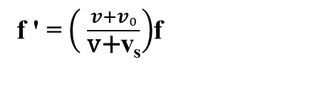




CASE VII:
1. When the source is followed by the observer.
When the source moves away while the observer moves towards it, In such case sound wave and source move in the opposite direction and, the sound wave and observer also move in opposite direction.
v
The observer moves toward the incoming waves, so effective speed of waves relative to observer,
$v′$= $v+v₀$
V=Velocity of sound
$v₀$= Velocity of observer
$\text{V}\text{s}$= Velocity of source
F = Orginal frequency of sound
f '= Apparent frequency
λ_{e}= Effective wavelength
T= Time period
and the apparent wavelength,
λ_{e}= $\frac{\text{v} \text{+} \text{v}\text{s} }{f}$
Apparent frequency heard,
f '= $\frac{v′}{\text{λ}\text{e}}$
Substituting values,
The apparent frequency of sound is,
f ' = $\left( \frac{v+v₀}{\text{v}\text{+}\text{v}\text{s}}\right)$f

Slide 9
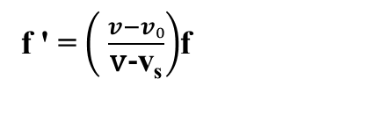



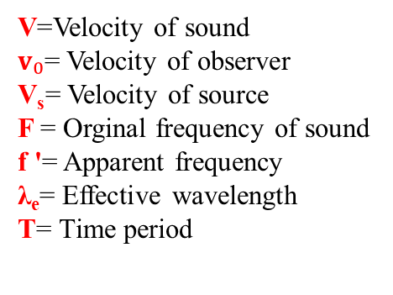
CASE VII:
2. When the observer is followed by the source.
When the observer moves away while the source moves towards it, In such case sound wave and source move in the same direction and, the sound wave and observer also move in same direction.
v
The observer moves away from the incoming waves, so the effective speed of waves relative to the observer decreases,
$v′$= $v−v₀$
and the apparent wavelength,
V=Velocity of sound
$v₀$= Velocity of observer
$\text{V}\text{s}$= Velocity of source
F = Orginal frequency of sound
f '= Apparent frequency
λ_{e}= Effective wavelength
T= Time period
λ_{e}= $\frac{\text{v} \text{−} \text{v}\text{s} }{f}$
Apparent frequency heard,
f '= $\frac{v′}{\text{λ}\text{e}}$
Substituting values,
The apparent frequency of sound is,
f ' = $\left( \frac{v−v₀}{\text{v}\text{−}\text{v}\text{s}}\right)$f

Slide 10
REAL-LIFE EXAMPLES & APPLICATIONS
Ambulance Siren: When an ambulance comes toward us, the siren sounds high-pitched, and when it moves away, the pitch decreases.
Train Whistles: The sound of a moving train changes as it approaches and passes by a station.
Radar Guns (Police): Doppler radar is used by traffic police to measure the speed of moving vehicles.
Weather Forecasting: Doppler radar is used to detect storms, wind direction, and rainfall.
Medical Field: Doppler ultrasound is used to measure the flow of blood in arteries and detect heart issues.

Slide 11
LIMITATIONS OF DOPPLER’S EFFECT
Assumes Low Speed: The formulas work accurately only when the speeds of the source and observer are much smaller than the speed of sound.
Medium Required: Sound Doppler Effect cannot occur in a vacuum because sound needs a medium.
Wind Effect: The presence of wind can change the speed of sound and cause errors.
Complex Motion: If the source or observer moves in a curved path instead of a straight line, the calculations become complicated.

